Slide 1
FAST FOURIER TRANSFORM (FFT)

Slide 2
DIVIDE AND CONQUER
(Review)
Karatsuba Integer Multiplication
MergeSort
Strassen’s Matrix Multiplication
Today: Polynomial Multiplication

Slide 3
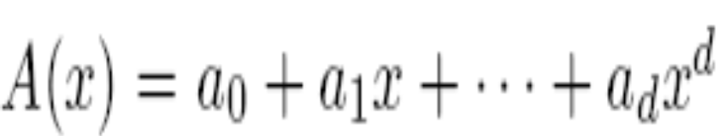
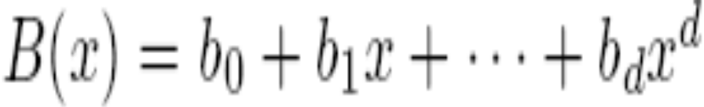
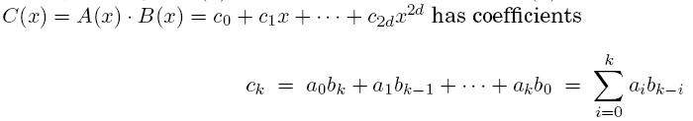
THE PROBLEM
Given two d-degree polynomials, compute their product.
X

Slide 4
Naïve (Direct) Algorithm
Applying the formula directly
O(d²) steps
Can we do better?
Yes, our solution is the FFT , an O (d log d) algorithm

Slide 5
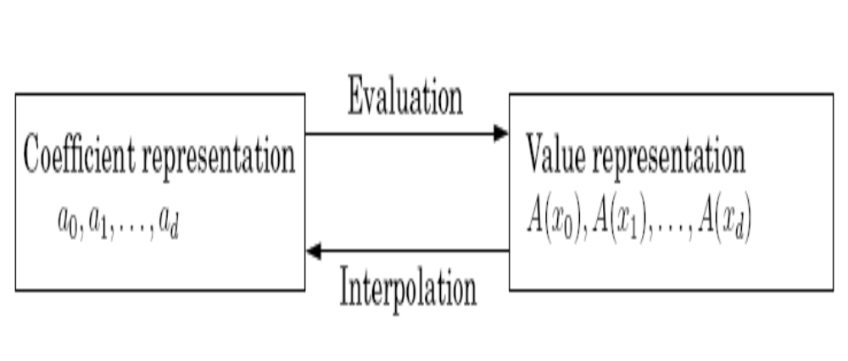
An Alternative Representation of Polynomials

Slide 6
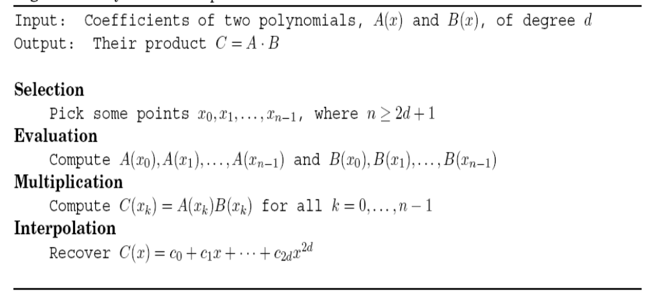
First Cut Solution
MAIN ISSUE: Evaluation step appears to be O(d²); and Interpolation is equally costly, if not more!

Slide 7
EVALUATION
By Divide-and-Conquer
Split d-Degree Polynomial into two d/2 Degree Polynomials:
Its odd and even powers

Slide 8
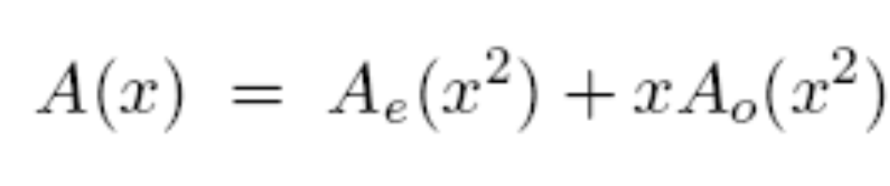
The odd and even powers of A(x)
Example: A(x) = 5 + 2x + 6x² + 3x³ + 7x⁴ + 8x⁵
A_{e} = (5 + 6x + 7x²) and A₀ = (2 + 3x + 8x²)

Slide 9

The Advantage
A(x) is evaluated at two points (namely x_{i} and -x_{i}) using just two evaluations of half the degree!

Slide 10
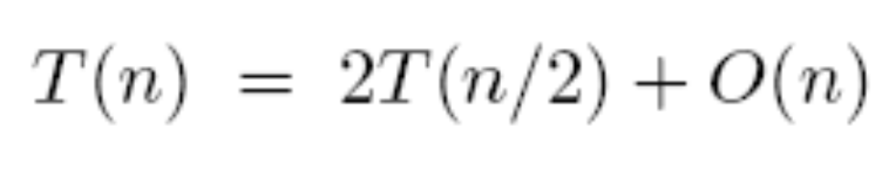
Consequently …
By recursion:
But … there’s a BIG problem!

Slide 11
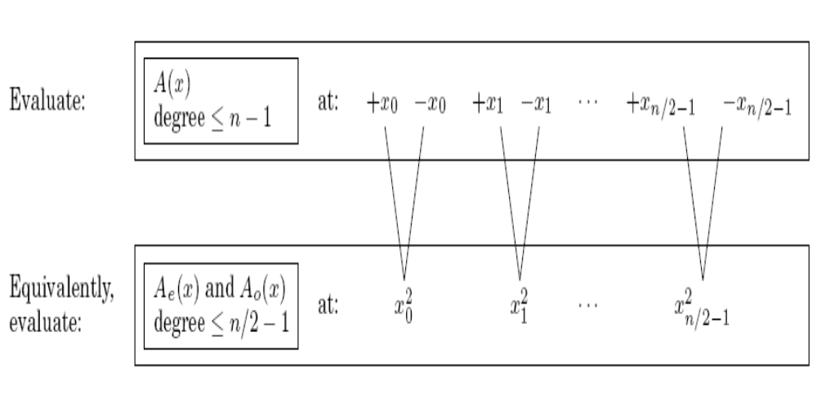

The trick works only at the first step/level of recursion, why?
aren’t plus/minus pairs. NO RECURSION!

Slide 12
THE WAY FORWARD
How can a square be negative?
The task seems impossible!
Unless, of course, we use complex numbers.

Slide 13
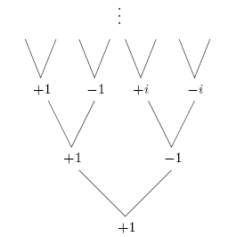
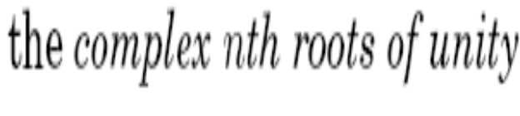
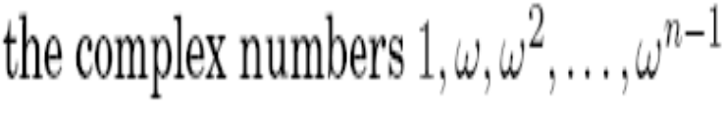
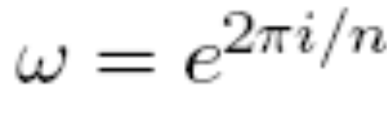
Which Complex Numbers to Use?

Slide 14
The Resulting Algorithm …
… is the Fast Fourier Transform (FFT)

Slide 15
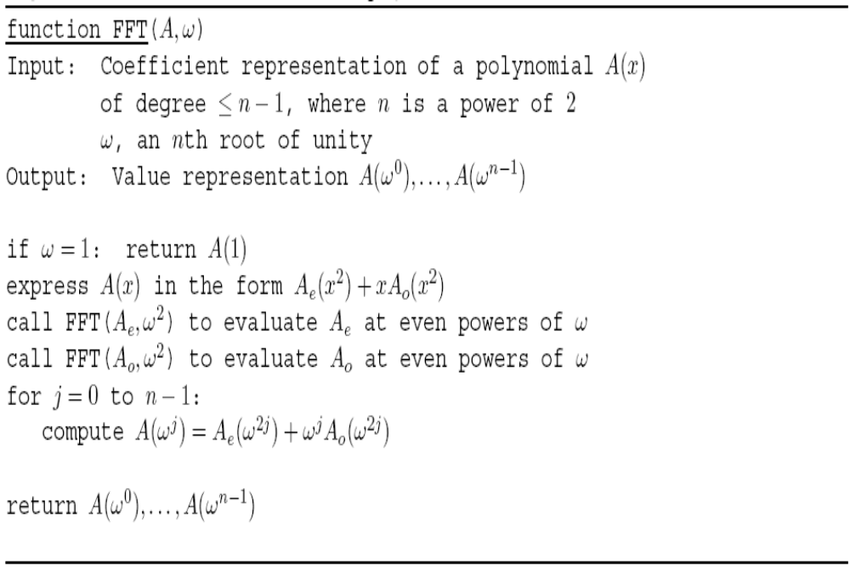
The FFT Algorithm

Slide 16
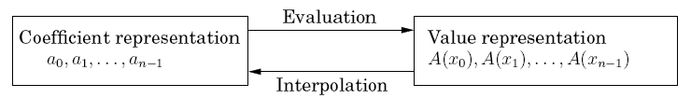
INTERPOLATION
By Divide-and-Conquer

Slide 17
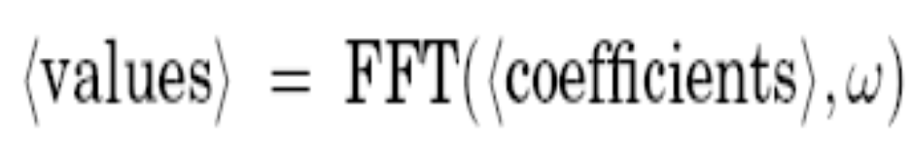
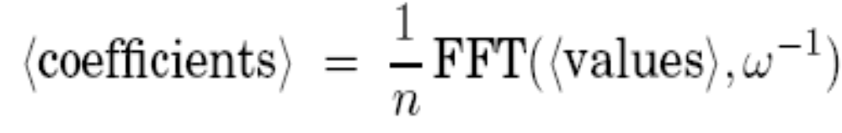
Amazingly …

Slide 18
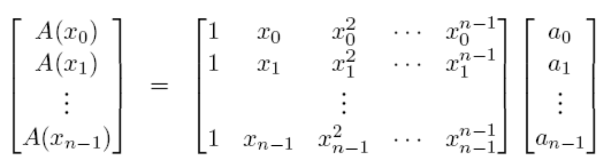
PROOF
Say, Matrix M

Slide 19
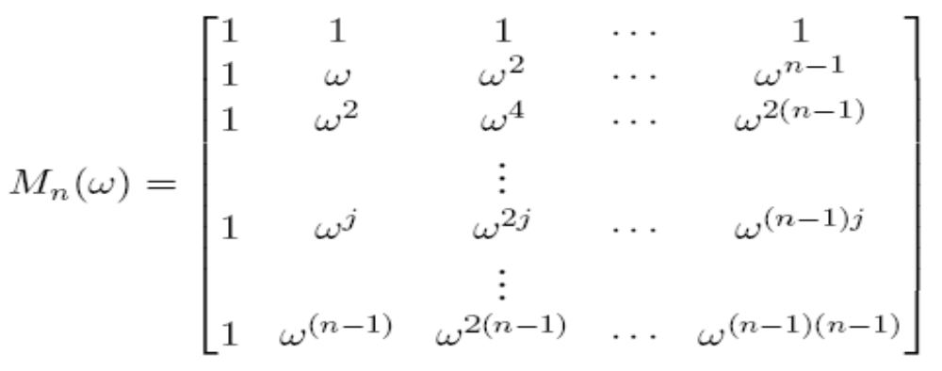

The FFT/DFT MATRIX

Slide 20
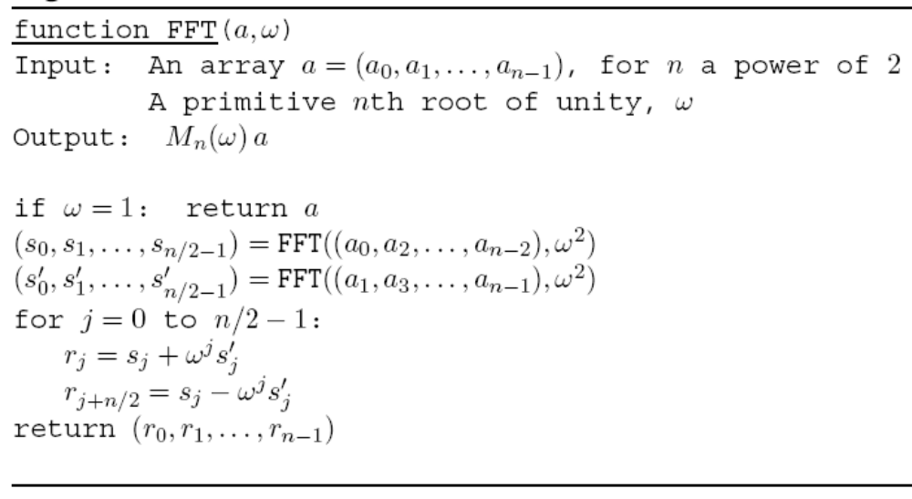
FFT ALGORITHM

Slide 21
O(d log d) Algorithm for Multiplying Two d-Degree Polynomials
SUMMARY

Slide 22
THANK YOU
Any Questions?

